Slide 1
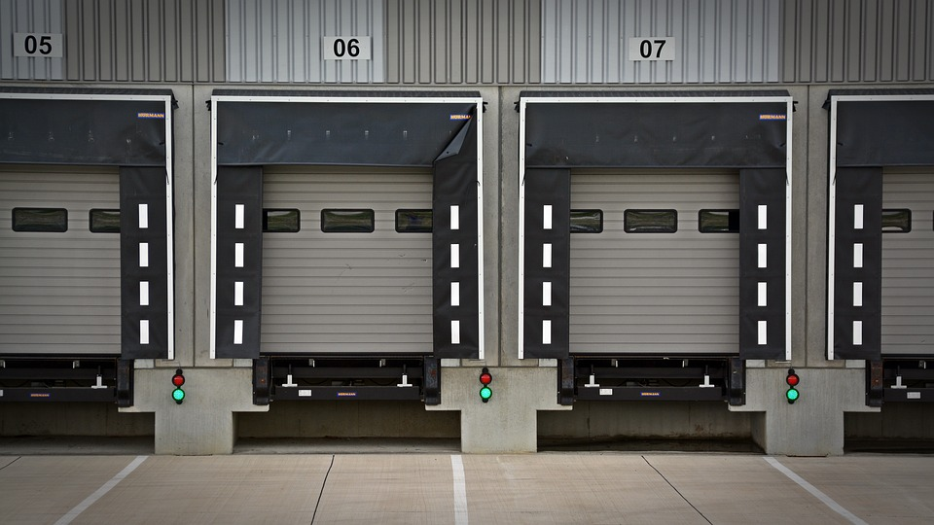
Business Process Integration Transport Company – Group 25
Emma Cañavate
David Galati
Lars Klunder
Miguel De La Cruz

Slide 2

Case Introduction
Uniprocterlevergamble Ltd. - Producer of fast moving consumer goods
Role of Transport Company (TC)
Crucial part in the supply chain
Ensuring timely and cost-effective delivery of goods
This Photo by Unknown Author is licensed under CC BY-SA

Slide 3
Intercommunication-lines

Slide 4
TC to TC communication
REST API
JSON
Multiple REST endpoints
Shared TC Database
Bidding system working

Slide 5
TC to CT communication
SOAP API
XML
Only posting orders

Slide 6
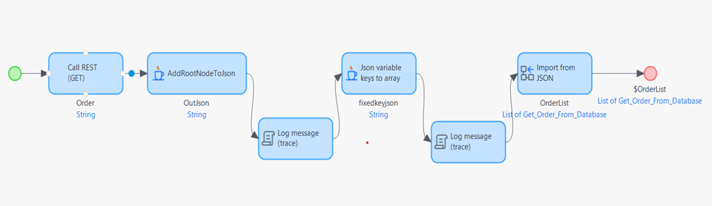
Problems
Communication issues
Last minute changes from other actors
Lack of control outside our team
Incompatibilities between seemignly ideentical formats caused set backs
Misallignment on assumptions

Slide 7


Competitive Advantage
We avoid information oversharing regarding orders
privacy
analysis, competitive prices
Interoperativity

Slide 8

Thank you!
Questions?

